Slide 1


Topic - EARTHING
By Team – MAGNUS
Sanskriti Sharma
Mayank Perwani
Kautik Bharadwaj
Mradul Agrawal

Slide 2
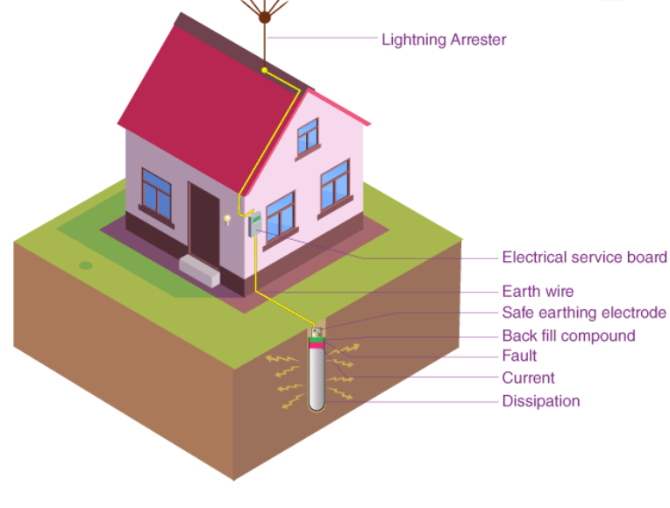
EARTHING –
“The process in which the instantaneous discharge of the electrical energy takes place by transferring charges directly to the earth through low resistance wire.”

Slide 3
TYPES OF EARTHING –
1. Pipe Earthing 2. Mat Earthing
Plate Earthing 4. Rod Earthing

Slide 4
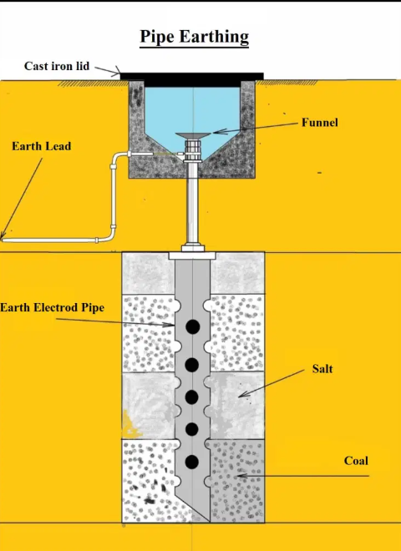
PIPE EARTHING
It uses a steel pipe to connect with the earth’s electrical conductors.
Soil moisture
Magnitude of the current

Slide 5
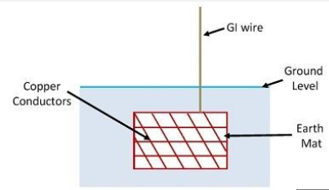
MAT EARTHING
It connects vertical and horizontal electrodes –
--- Horizontal electrode represses the current generated due to a massive fault
--- Vertical electrode dissipates the current into the earth.

Slide 6
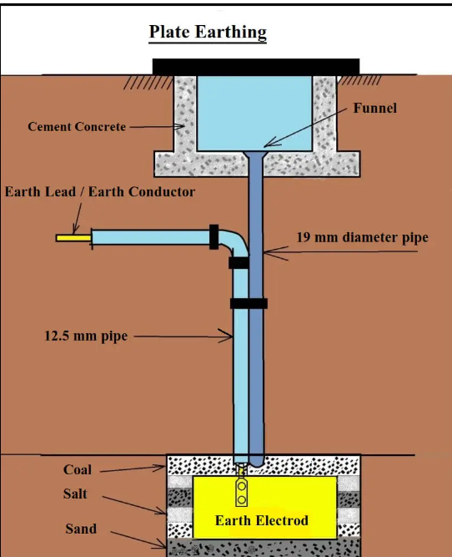
PLATE EARTHING
It is where a copper plate is distanced at 3 meters from the earth and vertically placed in the ground pit.

Slide 7
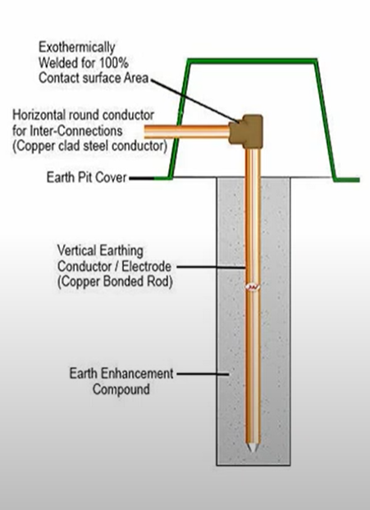
ROD EARTHING
A type of Earth Electrode.
(It is a conducting element buried directly in the ground, facilitating the flow of fault currents towards the ground)

Slide 8
What is Good Earthing ??
Good earthing must have low impedance enough to ensure that sufficient current flow through the safety device
So that it disconnect the supply (<0.4 sec)
Fault current is much more than full load current of the circuit which melts the fuse.
Appliance disconnects automatically.

